Slide 1

Wipro – Network Management System
ChangeNet AI
Intelligent Network Monitoring and Management
Done By
231001021 – ASWANTH V R

Slide 2
OUTLINE
Objective
Abstract
Introduction to Problem Domain
Existing System & Proposed System
Architectural Design for Proposed System
Algorithm / Techniques Used
Software Used
Modules Design & Description
Results & Performance Analysis
Comparative Study
Conclusion & Future Scope
References

Slide 3
OBJECTIVE
Goal:
To develop a simple, web-based network monitoring dashboard that tracks device status, shows simulated performance indicators, raises alerts and analyses device behaviour to estimate stability and change risk.
Key Features:
Admin login and a sidebar workspace with seven views.
Device inventory with search, status toggle and IPv4 validation.
Simulated live monitoring – CPU, memory, latency, packet loss, traffic trend.
Alert Center with priority levels.
Smart Analysis – Stability Score, Change Risk Indicator and Health Timeline.
Device Comparison and a printable Monitoring Report.
Impact:
One clear view of device health, alerts and change risk – no installation needed.

Slide 4
ABSTRACT
ChangeNet AI is a web-based network monitoring and change-analysis dashboard.
Built with plain HTML, CSS and JavaScript – no framework or database.
A welcome page leads to an admin login and the main dashboard.
Overview shows total devices, online devices, network usage, active alerts and a performance chart.
Devices page supports add, search and status toggle with IPv4 and duplicate-IP checks.
Monitoring page simulates CPU, memory, latency, packet loss and a live traffic trend.
Smart Analysis scores each device 0–100 and classifies Low / Medium / High change risk.
Compare Devices and Monitoring Report summarise stability for decision making.

Slide 5
INTRODUCTION TO PROBLEM DOMAIN
Current Network Monitoring Challenges
Small labs and offices track devices manually or in spreadsheets.
Enterprise monitoring tools are complex to install, configure and demonstrate.
Real ping monitoring needs firewall, ICMP and port configuration.
A plain status list does not show which devices are unreliable.
Status changes are rarely analysed, so risky devices go unnoticed.
Administrators get little guidance on where to focus attention.
Problem
There is a need for a simple, easy-to-run dashboard that monitors devices, raises alerts and explains device stability and change risk in plain language.

Slide 6
EXISTING SYSTEM
Existing System
Manual checking of devices and spreadsheet inventories.
Command-line ping tests, one device at a time.
Enterprise tools with complex setup, servers and databases.
Only the current status is shown – no stability measure.
No comparison between devices.
No ready-made summary report for administrators.
Little or no interpretation of monitoring data.

Slide 7
PROPOSED SYSTEM
Proposed System – ChangeNet AI
Single dashboard: overview, devices, monitoring, alerts, analysis, comparison and report.
Device management with IPv4 validation and duplicate-IP prevention.
Simulated monitoring (CPU, memory, latency, packet loss, traffic) – no real ICMP ping needed.
Alert Center with High / Medium priority events.
Stability Score (0–100) with Change Risk Indicator and Device Health Timeline.
Side-by-side Device Comparison and one-click Monitoring Report.
Runs in any browser – open index.html, no installation.

Slide 8
ARCHITECTURAL DESIGN FOR PROPOSED SYSTEM
CHANGENET AI – SYSTEM ARCHITECTURE
ADMINISTRATOR / USER
WEB INTERFACE (index.html)
Welcome · Admin Login · Sidebar Workspace
APPLICATION LOGIC (JavaScript)
DEVICE MANAGEMENT
Add / Search / Toggle
IPv4 + duplicate check
MONITORING & ALERTS
CPU · Memory · Latency
Traffic trend · Alerts
SMART ANALYSIS
Stability score
Change risk · Timeline
COMPARE & REPORT
Two-device comparison
Monitoring report
IN-PAGE DATA STORE (JavaScript arrays)
Devices · Alerts · Simulated Metrics

Slide 9
ALGORITHM / TECHNIQUES USED
Input Validation
IPv4 checked with a regular expression – four parts, each 0–255.
Duplicate IP addresses are rejected before a device is added.
Status Monitoring
Each device carries a status (Online / Offline); the toggle updates counts instantly.
Monitoring simulates metrics with bounded random variation every 3 seconds.
Stability Score (0–100) & Change Risk
Base score: 92 if Online, 48 if Offline; reduced by 7 × (device position mod 4).
Score is clamped between 20 and 98.
Risk level: Low (≥ 80), Medium (55–79), High (< 55).

Slide 10
RISK LEVELS & INSIGHT
LOW RISK
MEDIUM RISK
HIGH RISK
Score 80 – 100
Device is reasonably stable. Continue normal monitoring.
Score 55 – 79
Some instability. Watch for repeated status changes.
Score below 55
Frequent changes may need attention. Check power, cable and connectivity.
Smart Change Insight
Picks the device with the lowest score (below 70) as the focus device.
Reports its score and risk level in a plain-language sentence.
Below 55: “frequent status changes may require attention”; otherwise “reasonably stable”.

Slide 11
SOFTWARE USED
Frontend
Analytics
HTML5
CSS3 (grid, flexbox)
JavaScript (ES6)
Rule-based JS logic
Canvas API for traffic chart
Data
Backend (placeholder)
In-page JavaScript arrays
No database required
Node.js http server
/api/health endpoint only
Run Environment
Tools
Any modern web browser
No installation needed
Visual Studio Code
Browser DevTools

Slide 12
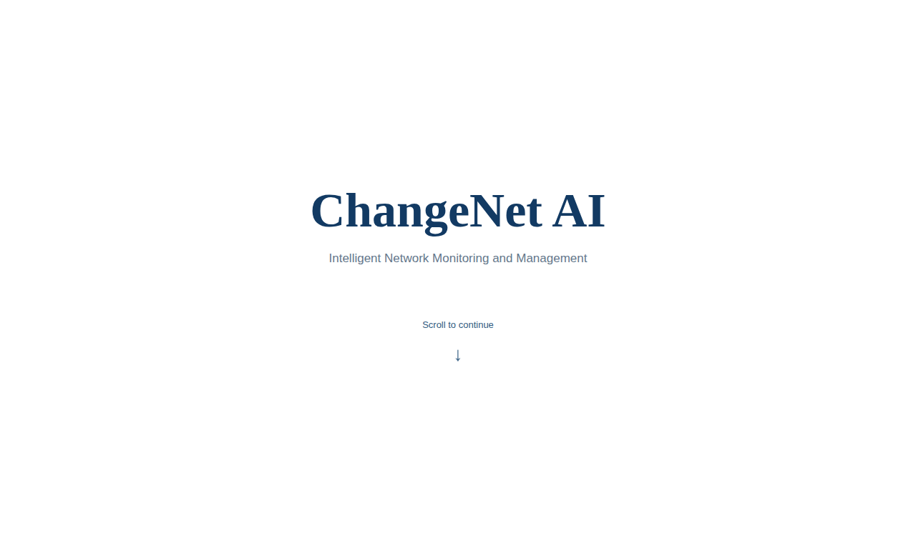
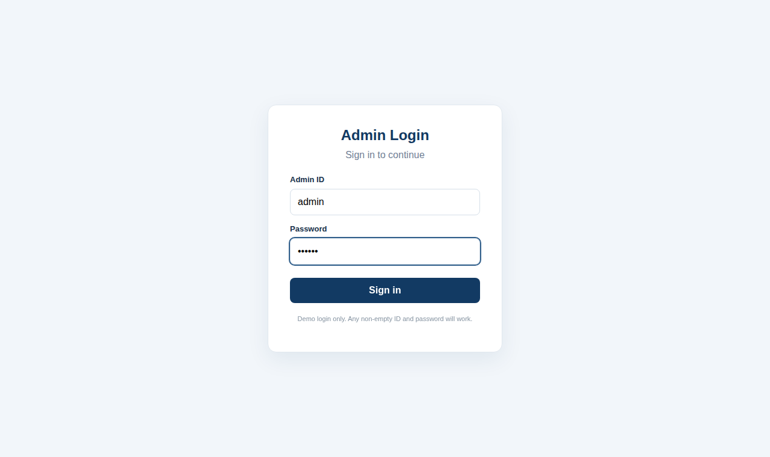
Module 1 – WELCOME PAGE & ADMIN LOGIN
Welcome page
Admin login
Welcome page shows the product name and a “Scroll to continue” prompt.
Admin Login asks for Admin ID and password.
Demo login only – any non-empty ID and password works.
After sign-in the dashboard opens; Sign out returns to the welcome page.

Slide 13
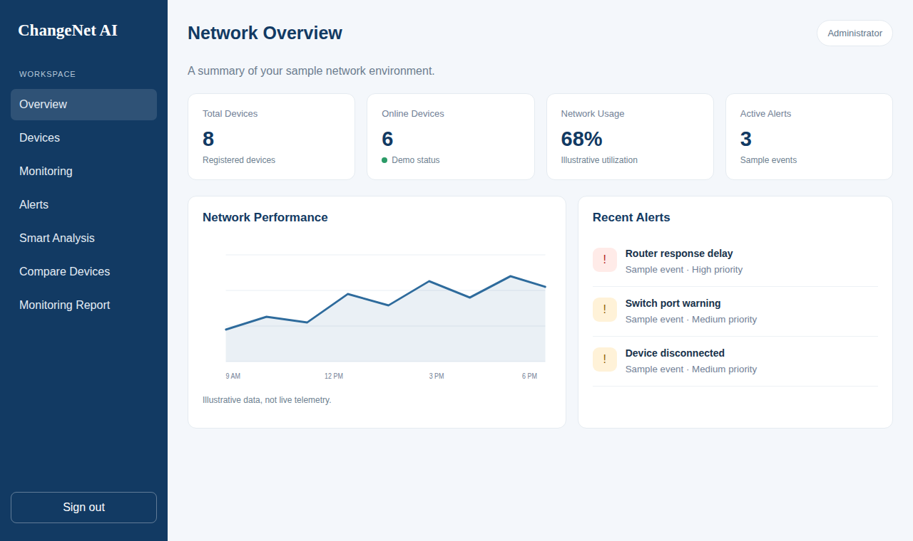
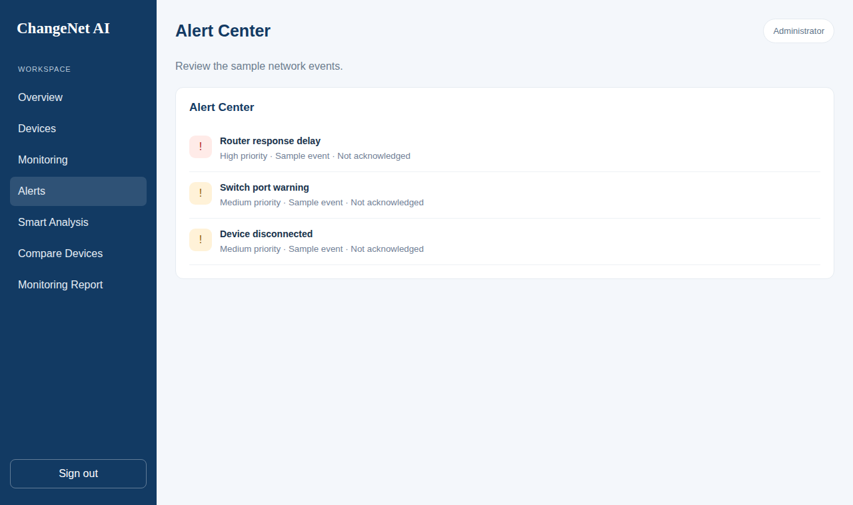
Module 2 – NETWORK OVERVIEW
Overview dashboard
Alert Center
Summary cards: Total Devices (8), Online Devices (6), Network Usage and Active Alerts.
Network Performance chart shows an illustrative usage trend.
Recent Alerts list shows the latest events with their priority.
Alert Center lists High and Medium priority events (e.g. device disconnected).

Slide 14
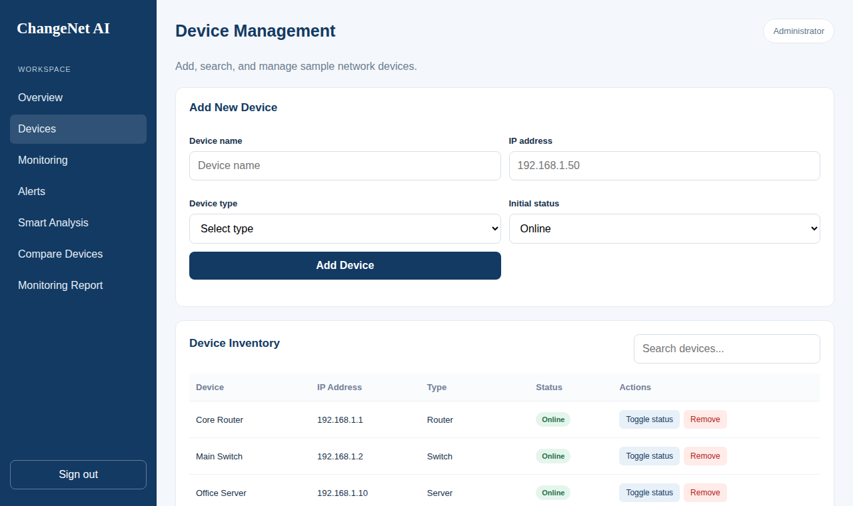
Module 3 – DEVICE MANAGEMENT
Features
Add a device: name, IPv4, type, status.
Types include Router, Switch, Server, Access Point, Computer.
Search by name, IP, type or status.
Toggle status Online ↔ Offline.
Add device form and inventory
Invalid IPv4 and duplicate IP addresses are rejected with a message.
Eight sample devices are pre-loaded for demonstration.

Slide 15
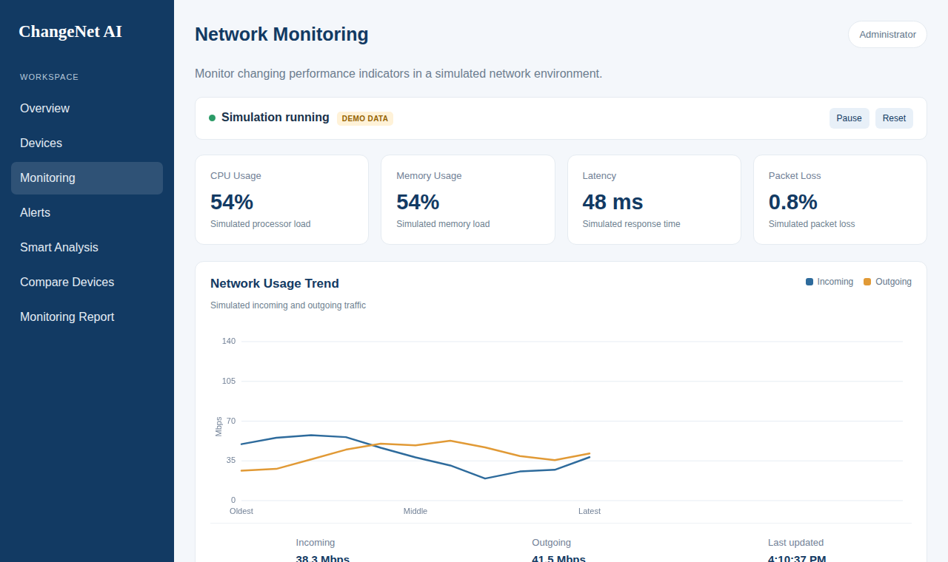
Module 4 – NETWORK MONITORING
Indicators
CPU usage
Memory usage
Latency (ms)
Packet loss (%)
Incoming / outgoing traffic
Simulated live monitoring
Values update every 3 seconds using bounded random variation – clearly labelled DEMO DATA.
Pause and Reset controls; the Network Usage Trend chart is drawn on an HTML canvas.
Simulation avoids firewall and ICMP setup, keeping the demo reliable.

Slide 16
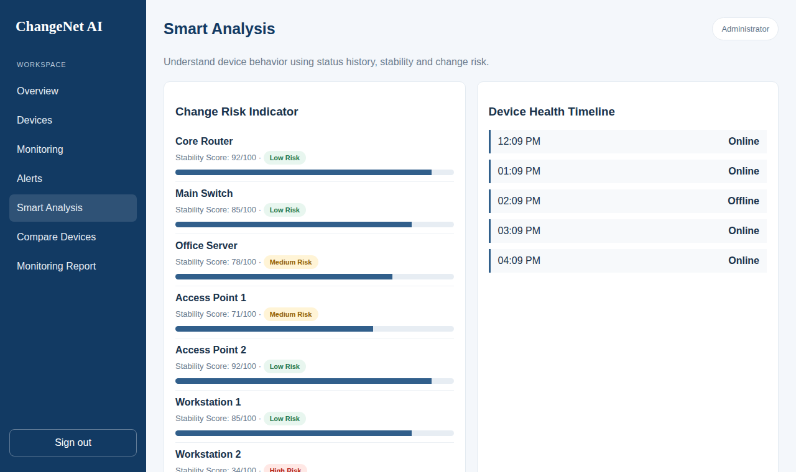
Module 5 – SMART ANALYSIS
Components
Stability Score per device (0–100) with progress bar.
Change Risk badge: Low / Medium / High.
Device Health Timeline of recent status entries.
Smart Change Insight sentence.
Change Risk Indicator & Health Timeline
Example: Workstation 2 scores 34/100 → High Risk; Core Router scores 92/100 → Low Risk.
Insight focuses on the lowest-scoring device so the administrator knows where to act first.

Slide 17
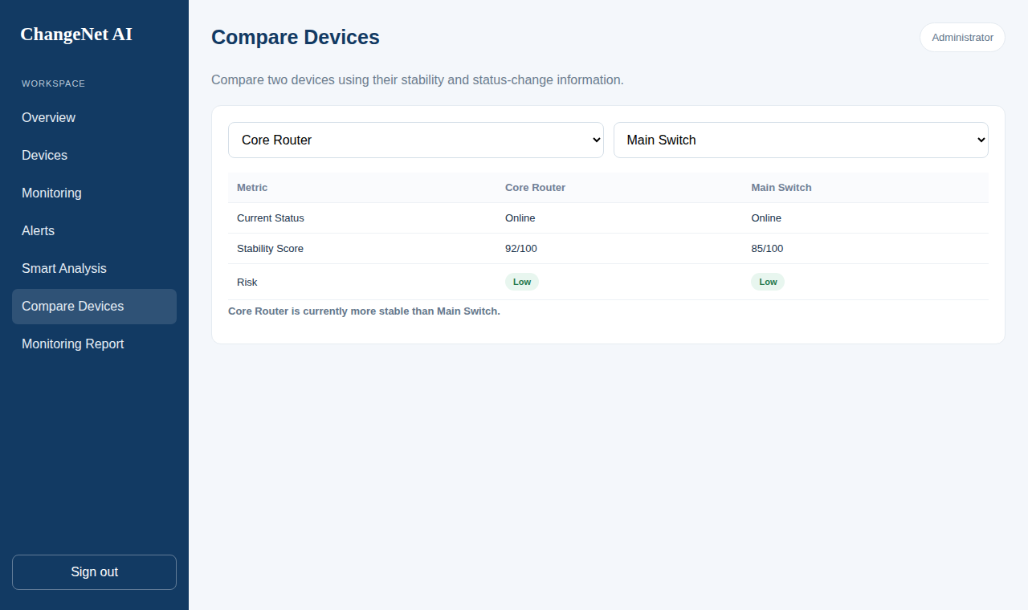
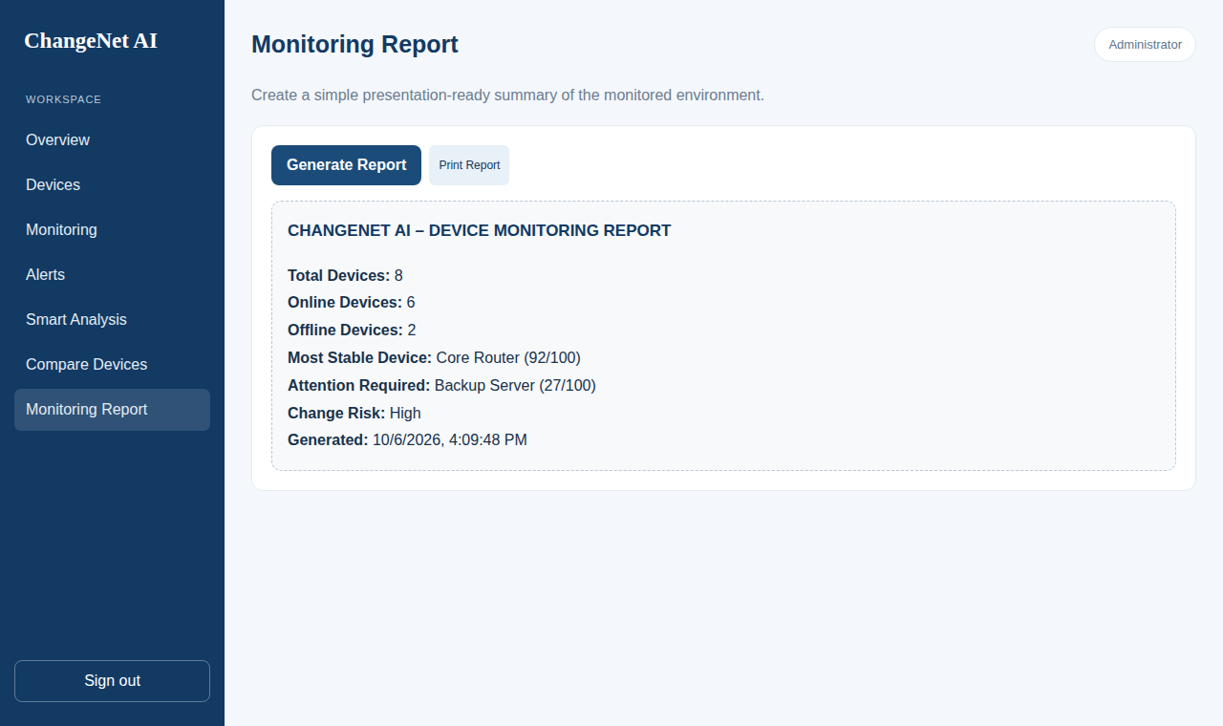
Module 6 – COMPARE DEVICES & REPORT
Compare Devices
Monitoring Report
Compare Devices: choose two devices to see status, stability score and risk side by side, with a verdict on which is more stable.
Monitoring Report: total, online and offline counts, most stable device, device needing attention, change risk and timestamp.
Print Report sends the summary to the browser print dialog.

Slide 18
Result and Performance Analysis
Left: demo network of 8 devices – 6 Online, 2 Offline.
Right: scores from the project’s formula; green = Low, amber = Medium, red = High risk.
Result: 4 Low-risk, 2 Medium-risk and 2 High-risk devices (Workstation 2, Backup Server).
Dashboard counts, analysis and report update immediately when device status is toggled.

Slide 19
COMPARATIVE STUDY
Feature | Existing System | ChangeNet AI
Setup | Complex installation | Open index.html – no install
Dependencies | Servers, agents, databases | Plain HTML, CSS, JavaScript
Device Management | Separate inventory sheets | Add / search / toggle status
Input Validation | Manual entry errors | IPv4 check + duplicate IP block
Monitoring | Command-line ping | Simulated metrics + traffic trend
Alerting | Complex rule setup | Alert Center with priorities
Device Reliability | Not measured | Stability Score (0–100)
Risk Assessment | Expert judgement needed | Low / Medium / High indicator
Device Comparison | Not available | Two-device side-by-side
Reporting | Manual compilation | One-click Monitoring Report
Demonstration | Firewall / ICMP setup | Works on any college PC

Slide 20
CONCLUSION & FUTURE SCOPE
Conclusion
ChangeNet AI delivers a simple, installation-free dashboard for monitoring devices and understanding their stability.
Stability Score, Change Risk, Comparison and Report turn raw status into actionable insight.
Future Scope
Real ping / SNMP-based status detection through the Node.js backend.
Persistent storage for devices, alerts and status-change history.
Event-based stability scoring using recorded Online → Offline changes.
Email / SMS alert notifications and role-based admin authentication.

Slide 21
REFERENCES
[1] J. Postel, “Internet Control Message Protocol,” RFC 792, Internet Engineering Task Force, Sep. 1981.
[2] J. Case, M. Fedor, M. Schoffstall and J. Davin, “A Simple Network Management Protocol (SNMP),” RFC 1157, Internet Engineering Task Force, May 1990.
[3] Mozilla Developer Network, “Canvas API,” MDN Web Docs. https://developer.mozilla.org/en-US/docs/Web/API/Canvas_API
[4] National Institute of Standards and Technology (NIST), “Network Management & Monitoring,” NIST. NIST Network Management and Monitoring
[5] Zabbix, “Network Monitoring,” Zabbix Documentation and Product Resources. Zabbix Network Monitoring

Slide 22
THANK YOU

